Slide 1
Sigma Mixer – Asset Monitoring
Technical – Solution Approach
Kamivisa Products -AJM

Slide 2
Background & Scope
A.J.M. India Private Limited was established in 1964 in Pondicherry, India. The primary manufacturing in the field of technical ceramics, plastic molded parts, metal components, and absorbent wicks
Kamivisa products is one of the wing from AJM group and producing absorbent wicks.
Kamivisa is wish to strengthen the technical stuff on the emerging technologies and enable IoT analysis on one of the key asset- sigma mixer by enabling IoT Dashboard
Inspirisys is one the pioneer in the IoT Stream and would like join the hand with AJM group of industries to enable the IoT Industry4.0 and strong the Digital transformation journey
Starting with one sigma mixer machine –IoT analysis dashboard to improve productivity and quality insights
Later extend Inspirisys IoT platform & Solutions for the enterprise level implementation

Slide 3


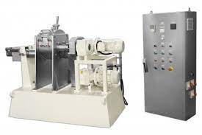


Data flow Architecture
Sensor and Microcontroller with Wired/Wireless communication
Sigma Mixer
IoT Gateway
Server/PC & App DB
Sigma mixer data acquisition via Wired /wireless communication peripheral(Vendor/OEM need to support on the data type and register values)
IoT Gateway will consolidate the data collection and post the data to application server
Deploy IoT server and application DB on the Server/high end PC
End user can login and see the dashboard
Application Dashboard

Slide 4
Data points & Dashboard
Data source Points
Dashboard fields
Mixer ID
Mixer On / Off Status
Mixer Loading Hatch Open / Close
Mixer Unloading Hatch Open / Close
Mixer In Operation / Idle Status (if On)
Mixer Cycle Time (if In Operation)
RPM of Sigma Blades (if In Operation)
Number of Mixes
Energy Consumed
Time (in HH:MM:SS) / Date (in DD-MMM-YYYY)
Total Time On / Off (in HH:MM) (across a time / date range)
Total Time Mixer Loading Hatch Open / Close (across time / date range)
Total Time Mixer Unloading Hatch Open / Close (across time / date range)
Total Time In Operation / Idle Status (in HH:MM) (across a time / date range)
Total Cycle Time (in HH:MM) (across a time / date range)
Minimum / Maximum / Average RPM (across a time / date range)
Total Number of Mixes (Count) (across a time / date range)
Total Energy Consumed (across a time / date range)

Slide 5
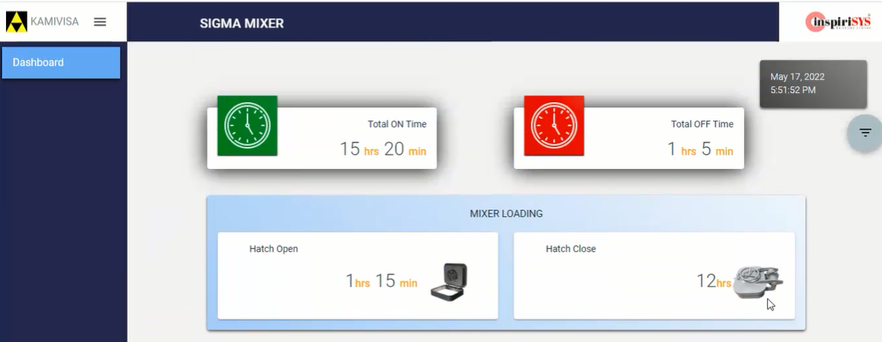

Sample Dashboard – Screen(1)

Slide 6
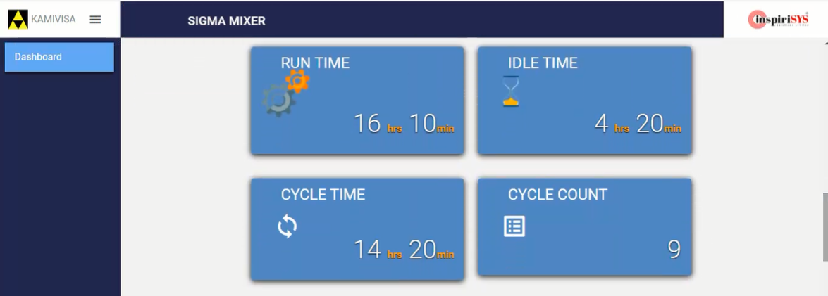
Sample Dashboard – Screen(2)

Slide 7
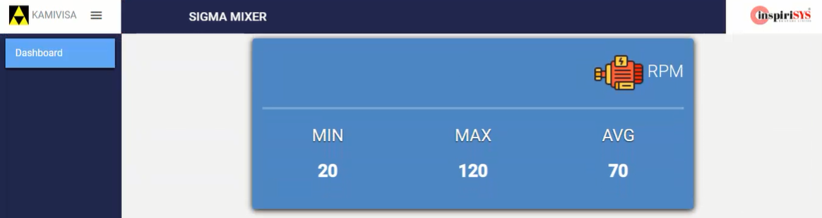

Sample Dashboard – Screen(3)

Slide 8
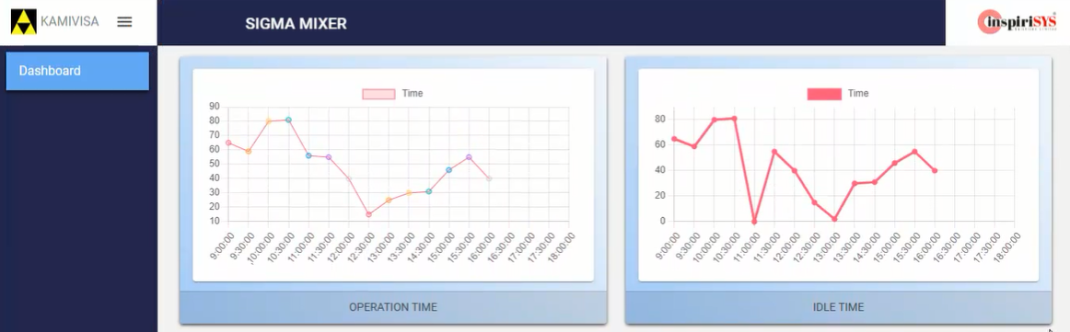
Sample Dashboard – Screen(4) – Trend

Slide 9
Deliverables
Edge Firmware deployment for the data acquisition
Formation of data exchange JSON via communication protocols like RS485/MQTT/Ethernet
Inspirisys IoT server and application DB deployment
Enable Dashboard access
Web Application Screens
Login Page
Consolidated Dashboard
Historical Data Analysis
Trend graph
Reports Download option

Slide 10
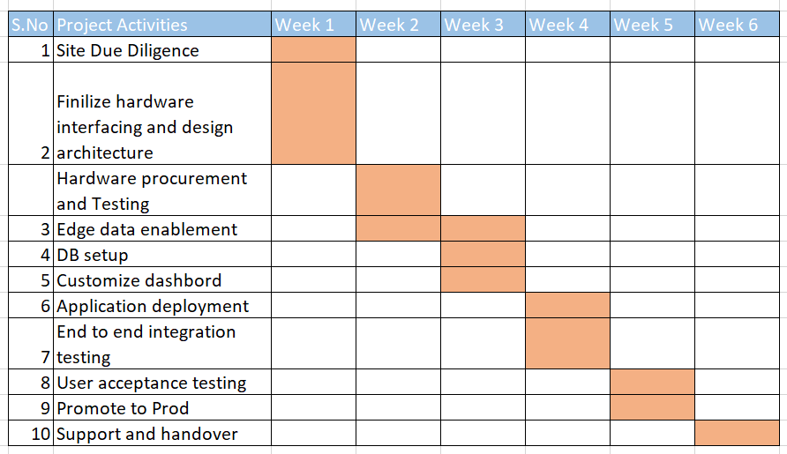
Project Activities & Timeline
*Note : 1. Actual quantity of hardware, spec and price will vary depends on site DD and field availability.
2. Assuming that AJM will provide required network connectivity and server.

Slide 11
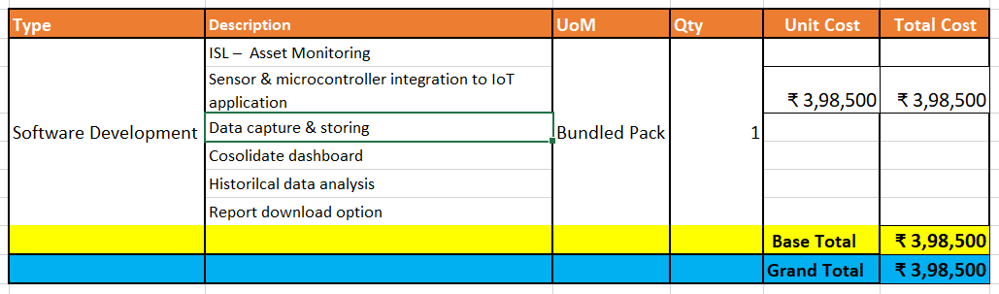
Software components - Commercial
*Note : Hardware price is not included, it will be same as actual.

